Slide 1

PYTHON • HR ANALYTICS • DECISION SUPPORT
Attrition Guard
Early Warning (Attrition) Indicator
YUVRAJ SINGH CHAUHAN
ROLL NO. 66 | DIVISION: BRAVO
Spot risk • Understand why • Take action
Experiential Learning Project
Python • Streamlit • HR Analytics
01

Slide 2
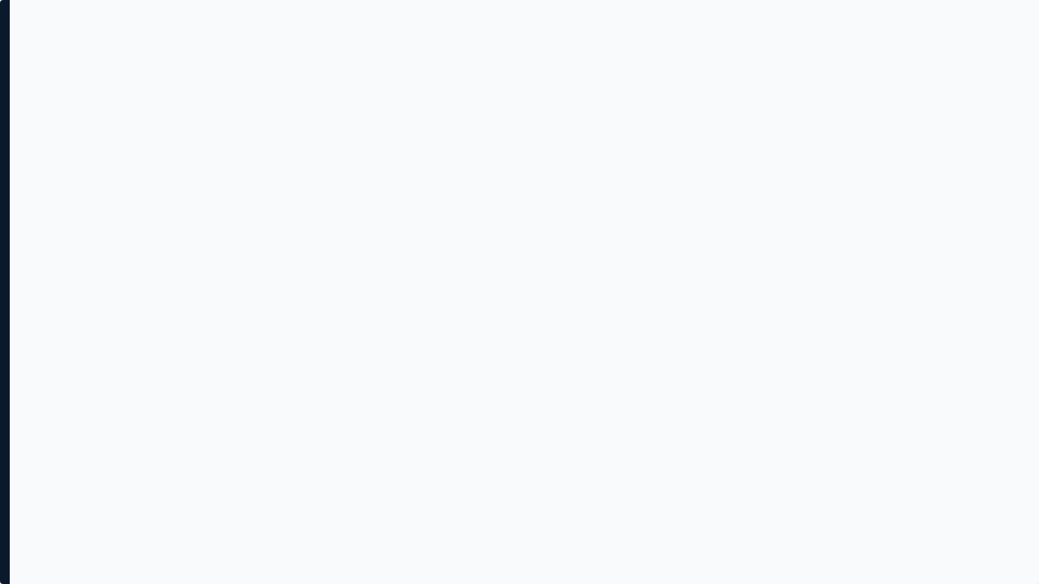


Business Context & Problem
The Cost of Reactive HR
High Turnover Costs: Organizations lose significant capital in recruitment, onboarding, and lost productivity when top talent leaves unexpectedly.
Reactive Processes: Traditionally, HR teams only discover employee dissatisfaction during exit interviews—when it is already too late to intervene.
The Need: HR requires a proactive, data-driven early-warning mechanism to identify flight risks and prioritize interventions appropriately.
02

Slide 3











Key Challenges To Address
Who is at risk?
How serious is it?
Why might they leave?
What should HR do?
Identifying hidden flight risks, especially among high-performing or tenured employees who may not voice dissatisfaction.
Quantifying an interpretable attrition risk score used to prioritize HR bandwidth and resource allocation effectively.
Pinpointing the root causes—whether it is salary stagnation, excessive workload, or lack of promotion.
Moving away from generic retention policies to targeted, personalized interventions based on specific data triggers.
03

Slide 4


Business Requirements
Core Assignment Scope
Added Project Scope
Import Data: Securely ingest and process historical employee datasets.
Interactive UI: Developed a fully functional Streamlit dashboard for real-time data exploration.
Risk Scoring: Calculate an interpretable attrition risk score based on predefined business rules.
Risk Grouping: Implemented Unsupervised ML (K-Means) to identify employee risk personas.
Highlight Risk: Visually flag high-risk employees for immediate management visibility.
Explainable AI Profile: Granular view of individual risk drivers for complete transparency.
Recommend Actions: Provide specific interventions tied directly to the calculated reasons for leaving.
Action Center: A dedicated module summarizing urgent retention strategies.
04

Slide 5




Our Solution: Attrition Guard Workflow
Employee Data
Risk Scoring
Risk Explorer
Retention Action
Automated ingestion of CSV datasets containing performance, HR, and behavioral metrics.
Rule-based engine calculates an aggregate score (0-100) and assigns Low, Med, High tiers.
Interactive dashboard to filter workforce by department, salary, and identified risk groups.
System prescribes targeted interventions (e.g., Comp Review) for HR execution.
05

Slide 6
Assumptions & Expanded Scope
A. Assumptions
B. Features Beyond Assignment
Data Quality: The ingested employee dataset is pre-cleaned and normalized.
K-Means Clustering: Added an ML module to segment high-risk employees into actionable "Personas" based on shared traits.
Metric Scales: Satisfaction and evaluation scores in the supplied dataset use a 0–1 scale.
Dynamic Filtering: Built a robust UI allowing HR to slice data dynamically rather than viewing static reports.
Binary Flags: Work accidents and promotion history are binary indicators.
Explainability Layer: The application breaks down the specific point contributions for each employee's score.
Weighting Efficacy: The predefined business rules (e.g., Satisfaction holding 30% weight) reflect a reasonable organizational baseline.
06

Slide 7
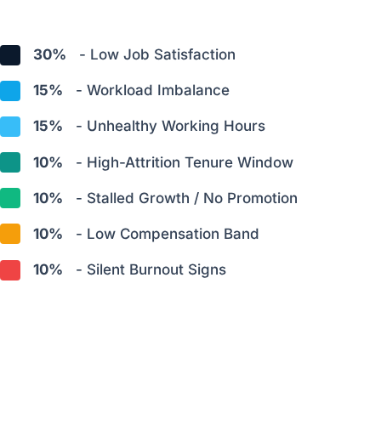
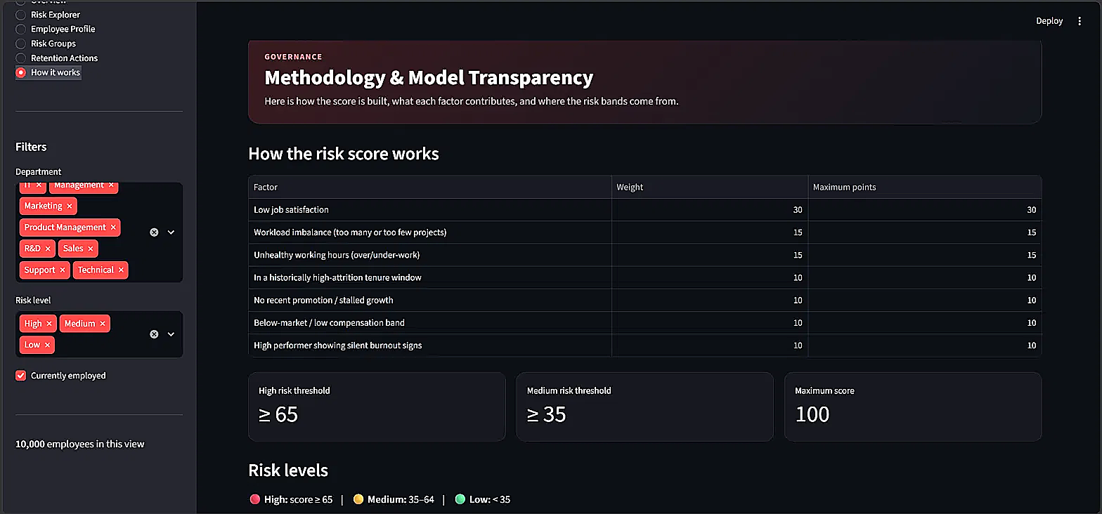

Risk Scoring Framework
Risk Score Components (Total 100%):
Implemented Risk Thresholds
*See Appendix for detailed scoring calculation rules.
07

Slide 8
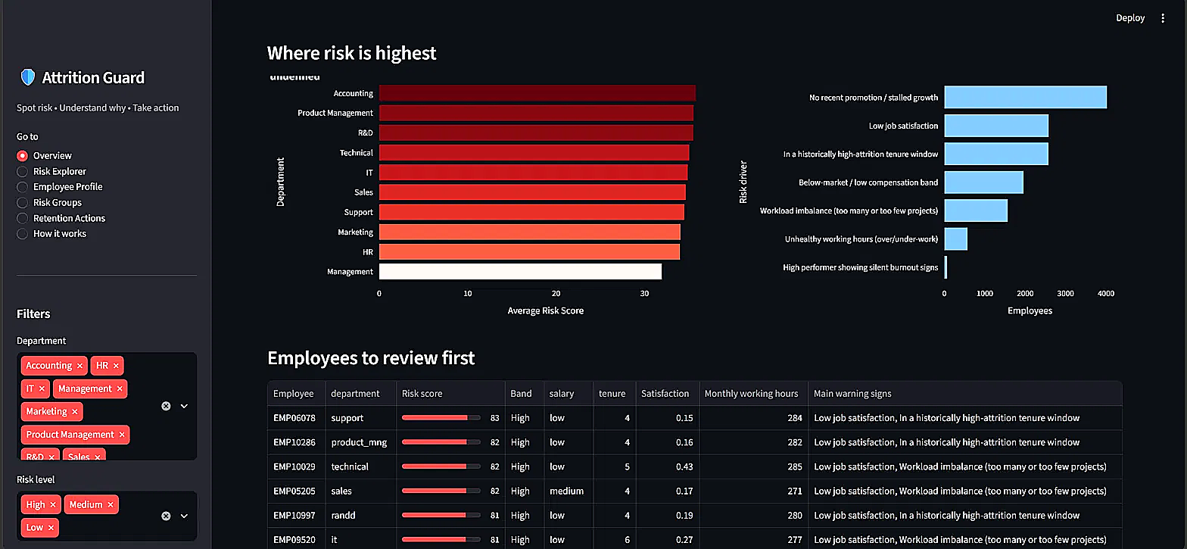





The Risk Landscape
Current Filtered View
Macro-level baseline of attrition risk based on the active dataset.
10,000
34.7
EMPLOYEES IN VIEW
AVG RISK SCORE
HIGH RISK
184
MEDIUM RISK
4,330
Analytical view: department hotspots, common drivers, and employees to review first.
LOW RISK
5,486
08

Slide 9
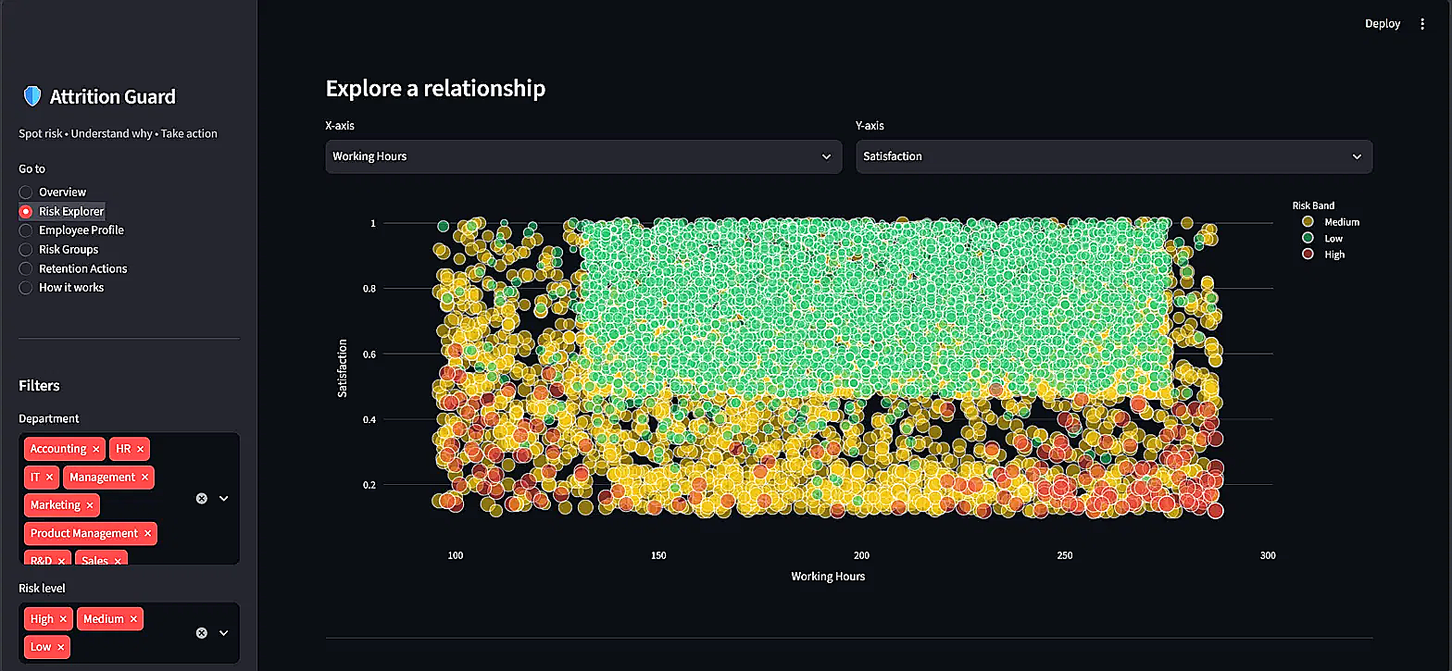
Risk Explorer
Interactive Data Exploration
The Risk Explorer module provides HR with a dynamic tool to visually investigate underlying workforce trends.
Interactive Selection: Map any two attributes (e.g., Working Hours vs. Satisfaction) on the X and Y axes.
Relationship Visualization: Explore visual relationships between employee attributes and observed risk bands.
Dynamic Filtering: Narrow the scope by Department or Risk Level using the sidebar controls.
Interactive scatter view: change X/Y attributes and narrow the workforce using sidebar filters.
09

Slide 10
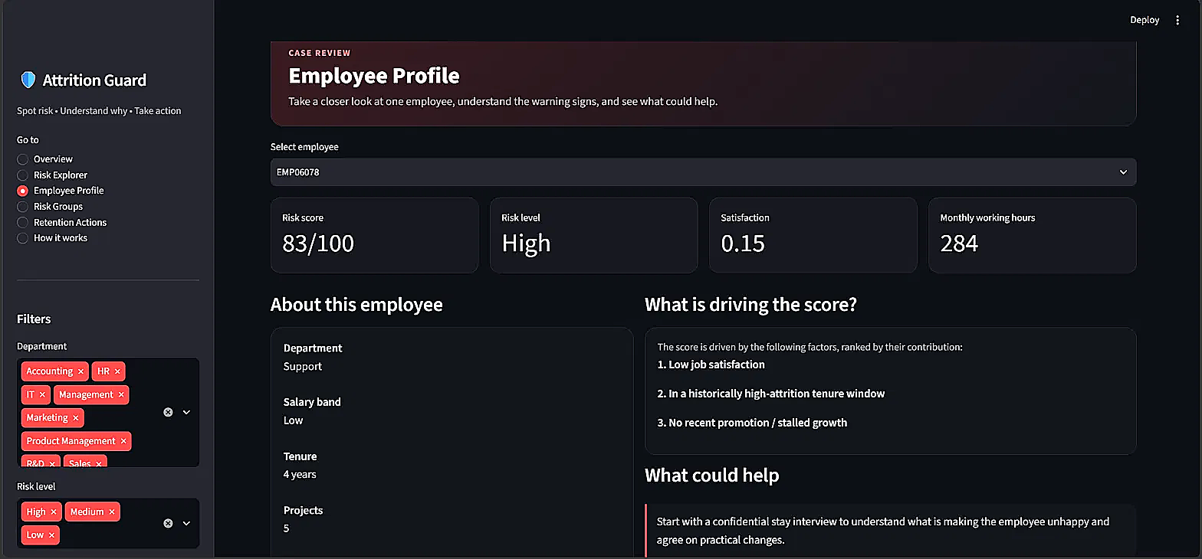

Employee-Level Explainability
Beyond the Black Box
The application identifies specific warning signs rather than just outputting a numerical score, indicating why an employee is flagged.
Profile: EMP06078
Support Dept | Low Salary | 4 Yrs Tenure
Risk Score: 83/100 (High)
Primary Drivers:
•
Low job satisfaction (0.15)
•
Historically high-attrition tenure window
•
No recent promotion / stalled growth
10

Slide 11
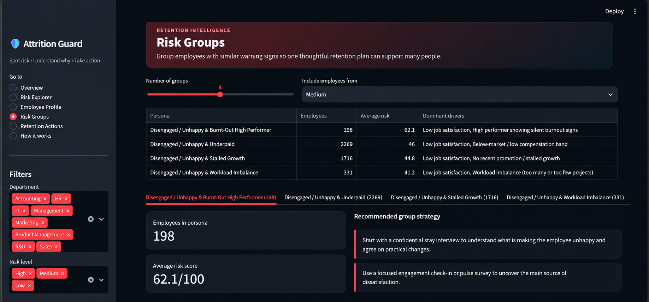
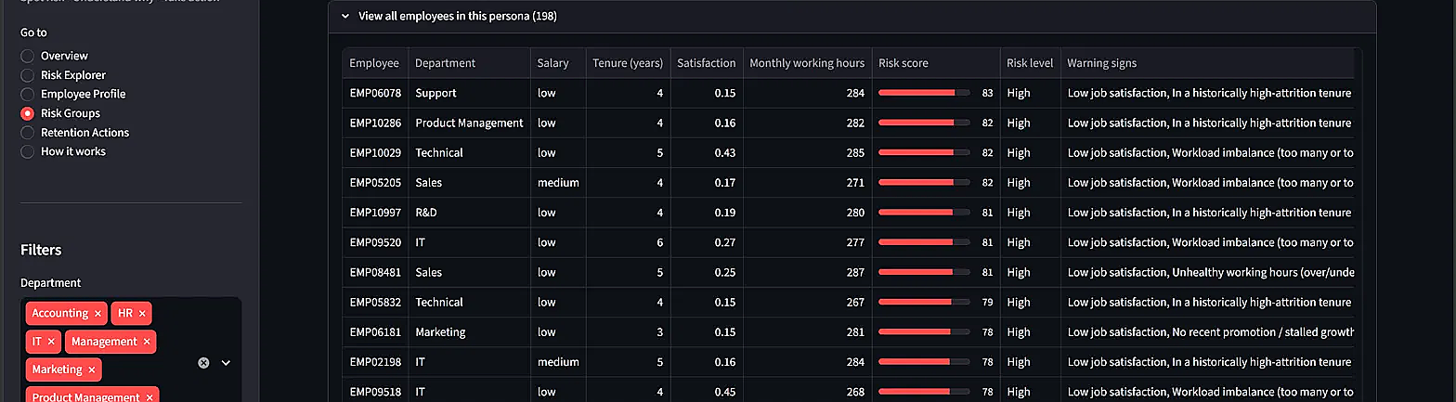
Risk Groups & Employee Personas
Utilizing Scikit-Learn's K-Means clustering, the system identifies data-driven risk personas. This allows HR to design group-level retention approaches rather than reviewing every employee independently.
11

Slide 12
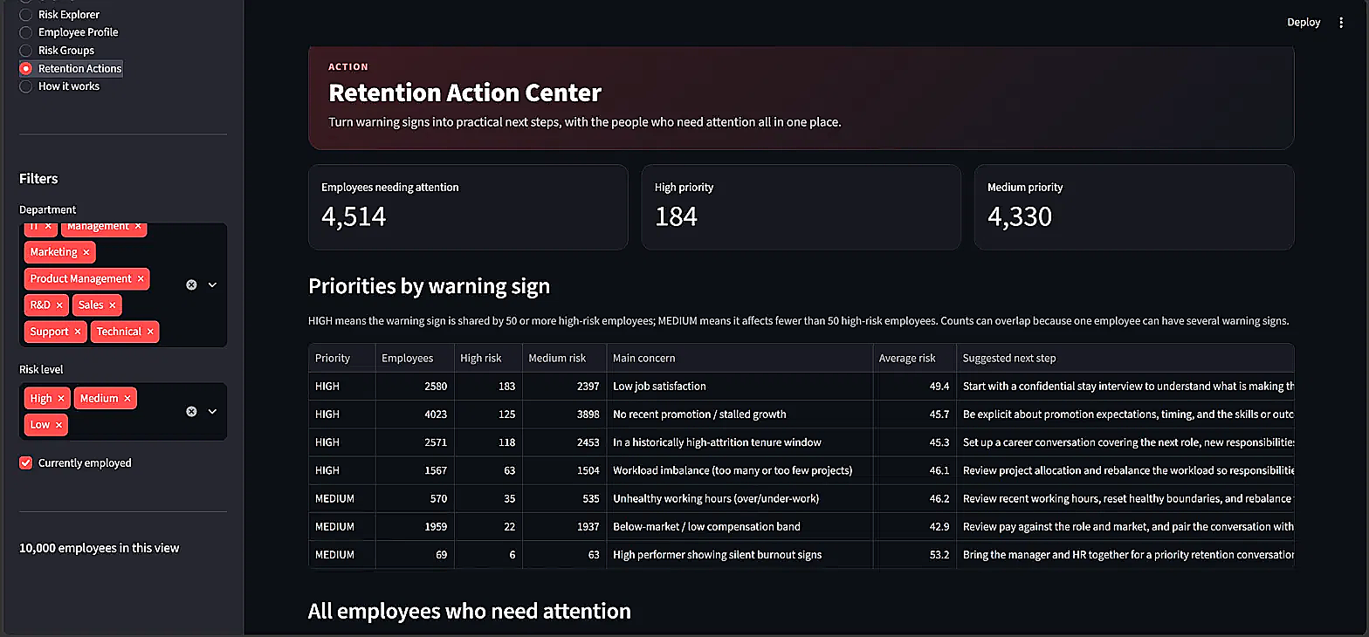



Retention Action Center
Retention Planning & Prioritization
This module bridges the gap between identifying risk and taking action, aggregating employees who require attention in the current view.
TOTAL NEEDING ATTENTION
4,514
HIGH PRIORITY
MEDIUM PRIORITY
184
4,330
12

Slide 13
Retention Strategy Framework
Identified Warning Sign | Core HR Concern | Recommended Intervention Approach
Low Satisfaction | Engagement & Morale | Action Conduct stay interview / check-in to identify grievances.
Workload Imbalance | Workload Pressure | Priority Review project allocation and role support structure.
Unhealthy Working Hours | Burnout Concern | Action Review working-hours and consider schedule adjustments.
Tenure-Related Risk | Career Stagnation | Action Discuss career pathing, mentoring, or internal mobility.
Stalled Growth (Promo) | Growth Concern | Action Set clear promotion expectations / development plan.
Low Salary Band | Compensation Concern | Priority Benchmark market rates and discuss pay progression.
High Risk Flag Overall | Priority HR Attention | Critical HR Business Partner requires closer review of the profile.
13

Slide 14

Technology & Implementation
Application Architecture Flow
Python 3.13
(Core Logic)
Pandas
(Data Processing)
Scikit-Learn
(Clustering)
Streamlit
(Interactive UI)
Primary Libraries & Versions
AI-Assisted Development
Streamlit ≥1.30: Web application UI
Brainstorming risk scoring rule logic
Pandas ≥1.5: Data processing & aggregation
Debugging Python and Streamlit execution errors
Scikit-learn ≥1.3: K-Means clustering
Code formatting and UI layout refinement
Plotly ≥5.18 / Matplotlib ≥3.5: Data visualizations
14

Slide 15





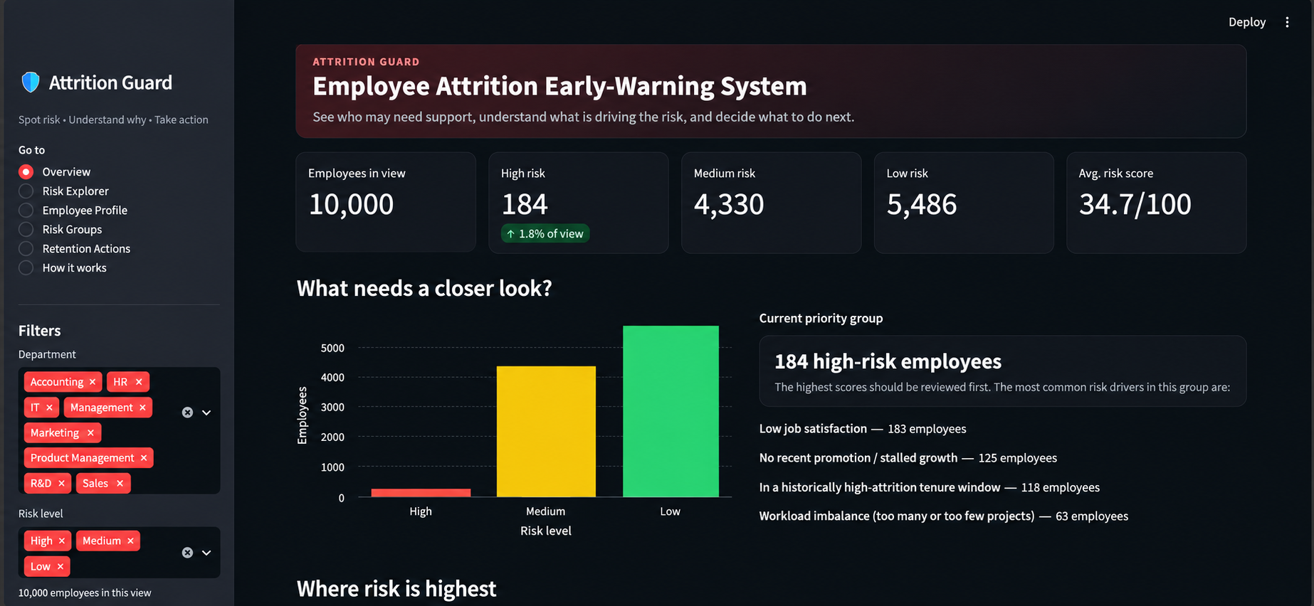
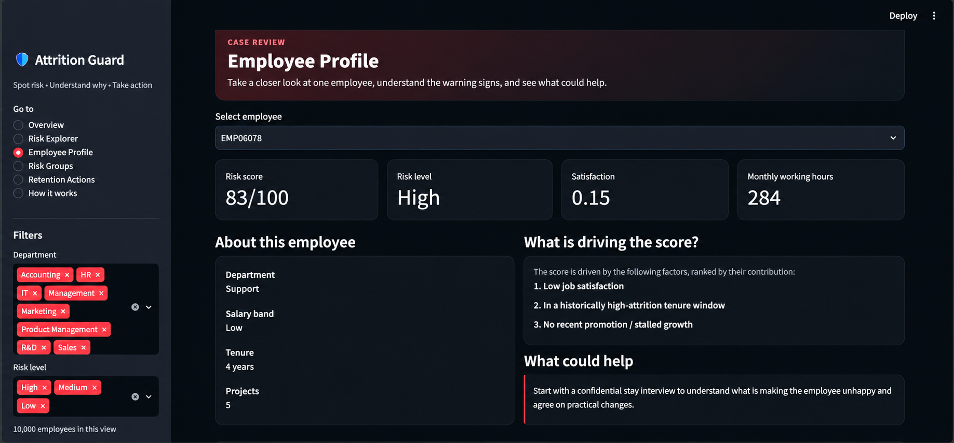
How to Use: User Journey
1. Launch App
2. View Overview
3. Explore Risk
4. Analyze Profile
5. Plan Actions
15

Slide 16





Development Challenges & Mitigation
1. Metric Normalization
2. Meaningful Grouping
Challenge: Different employee attributes have vastly different scales (e.g., Working hours vs. 0-1 Satisfaction ratings).
Challenge: Static filtering alone does not intuitively reveal common underlying risk patterns across a large workforce.
Mitigation:
Mitigation:
Implemented a weighted, threshold-based scoring framework mapping diverse data inputs to a unified 0-100 scale based on business rules.
Applied Scikit-Learn's K-Means clustering algorithm on risk components to generate actionable, data-driven employee risk personas.
16

Slide 17
Future Requirements
System Evolution
FUTURE ROADMAP
Phase 1: Additional employee attributes and richer HR data integration.
Add employee attributes and deeper HR data integration.
PHASE 1
Richer HR data
Phase 2: Evaluate predictive ML models using historical attrition outcomes.
Evaluate predictive models using historical attrition outcomes.
PHASE 2
Predictive ML
Phase 3: Potential secure HRIS integration (e.g., Workday API).
Phase 4: Intervention tracking and retention outcome measurement.
Explore secure HRIS connectivity such as Workday API.
PHASE 3
HRIS integration
"From identifying attrition risk to enabling timely retention action."
Track interventions and measure retention outcomes.
PHASE 4
Outcome tracking
17

Slide 18
Appendix: Detailed Risk Scoring Rules
Risk Factor | Max Points | Implemented Business Rule
Low Job Satisfaction | 30 | Scales inversely with the satisfaction score.
Workload Imbalance | 15 | 3–4 projects = optimal; 5–6 = mild risk; ≤2 or ≥7 = full workload penalty.
Unhealthy Working Hours | 15 | 150–240 hours = healthy; outside this range adds risk, capped at 310 hours.
High-Attrition Tenure | 10 | 4–5 years = high-risk zone; 3–6 years = medium concern.
Stalled Growth | 10 | No promotion in 5 years; stronger penalty for employees with tenure ≥3 years.
Low Compensation | 10 | Low band = full penalty; medium = half; high = zero.
Silent Burnout Signs | 10 | Evaluation ≥0.80, hours ≥220/month, and satisfaction ≤0.50 trigger burnout flight-risk penalty.
Total Maximum Score: 100. High Risk Threshold: ≥ 65. Medium Risk Threshold: ≥ 35.
18

Slide 19
Thank You
Questions & Discussion
19

